Slide 1
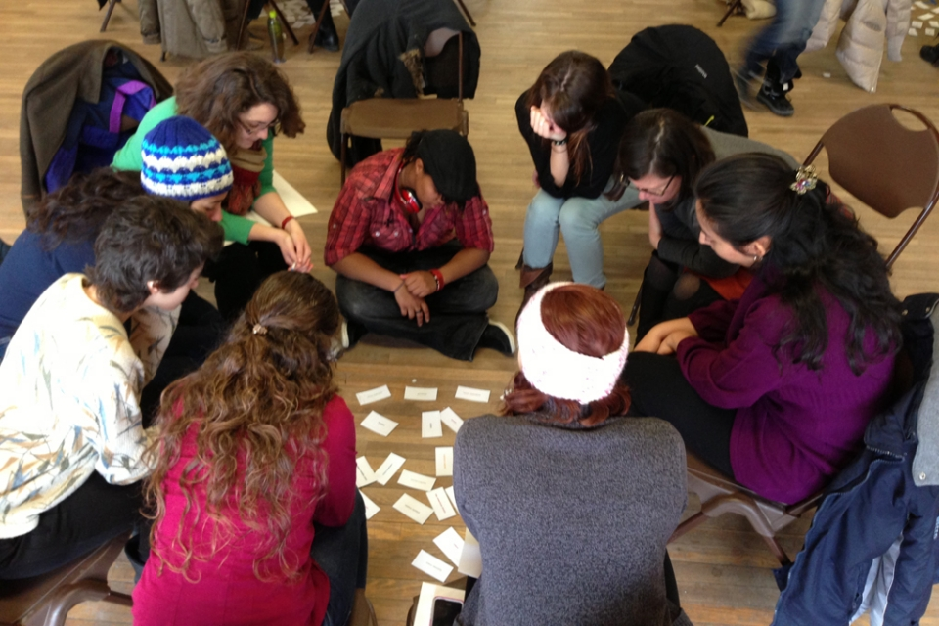
Discussion in the Classroom:
A Powerful Tool for Comprehension
Illinois New Teacher Collaborative Conference
Gail Huizinga
ghuizinga@sbcglobal.net

Slide 2
Goals for Session
Support and strengthen rich student discussion
Empower students to create meaning and deepen their learning

Slide 3
Think-Write-Pair-Share
A brainstorming strategy that provides “think time”
Pose a question or pick a topic.
Think about what you know and record it.
Pair with a partner to gain more information.
Share with the whole group.
  Allows students time to verify and add to first thoughts.
  Works well with brainstorming.
  Students can ask the initial question.
  Allows students to jot down their thoughts and increases participation in discussion

Slide 4
Discussion
CCR Anchor Standards
Speaking & Listening - Comprehension & Collaboration
Prepare for and participate effectively in a range of conversations and collaborations with diverse partners, building on others’ ideas and expressing their own clearly and persuasively.
Integrate and evaluate information presented in diverse media and formats, including visually, quantitatively, and orally.
Notes:
4

Slide 5



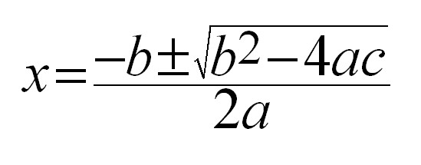
TEXT
Any Communication Involving Language.
Complex Text Analysis

Slide 6
Old Paradigm | New Paradigm
Teacher centered instruction | Student centered learning
Single media | Multi media
Solitary work | Collaborative work
Information delivery | Information exchange
Passive, receptive learning | Active, inquiry based learning
Factual knowledge based | Critical thinking
Notes:
This table illustrates the paradigm shifts necessary to meet the new 21st century learning standards.
Please take a moment to review this table
what you notice about the shifts from the old paradigm to the new?
RESPONSE: The 21st Century learner requires instruction that is engaging and varied. It follows a more constructivist approach where learning must be released to the learner.

Slide 7
3b: Using Questioning and Discussion Techniques
Quality of questions/prompts
Discussion techniques
Student participation
Adapted from C. Danielson, 2007

Slide 8

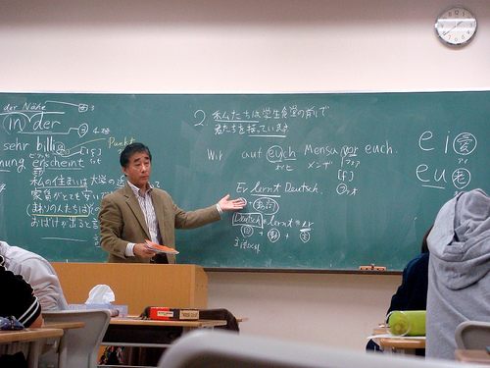


Monologic vs Dialogic Classrooms
Maintain control of the talk
vs
Exploration and collaborative talk

Slide 9
Dialogic Classroom
Negotiate meaning from other’s perspectives
Improves comprehension and critical thinking skills
Symmetrical rather then asymmetrical power relationship
Students value their conversations
Promotes collaborative inquiry
Allows for uncertainty which enables dialogue.
Opening Minds: Using Language to Change Lives,
Peter J. Johnston, 2012, Stenhouse

Slide 10
Metacognition
Thinking about your own thinking
Knowing if I understand.
2. Knowing what to do if I don’t.
Notes:
10

Slide 11
Are you hearing voices as you read?
RECITING VOICE – The voice a reader hears when he/she is only reciting the words and not drawing meaning from the text.
CONVERSATION VOICE – The voice that has a conversation with the text. It represents the reader’s thinking as she/he talks back to the text in an interactive way.
    Interacting Voice – asks questions, make connections, identifies confusions, agrees and disagrees with ideas.
    Distracting Voice – pulls the reader away from the meaning of the text. The reader begins to think about something else.
Adapted from Tovani, Cris. 2000. I Read It, But I Don’t Get It: Comprehension Strategies for Adolescent Readers. Portland, MA: Stenhouse.

Slide 12
Annotation is a note of any form made while reading text.
DD. Fisher and N. Frey
Notes:
Learners need to record their thinking in some way so they can share their thoughts with others.
Annotation can take many forms beyond written expression. It can be a drawing, diagram, symbol code, color coded

Slide 13
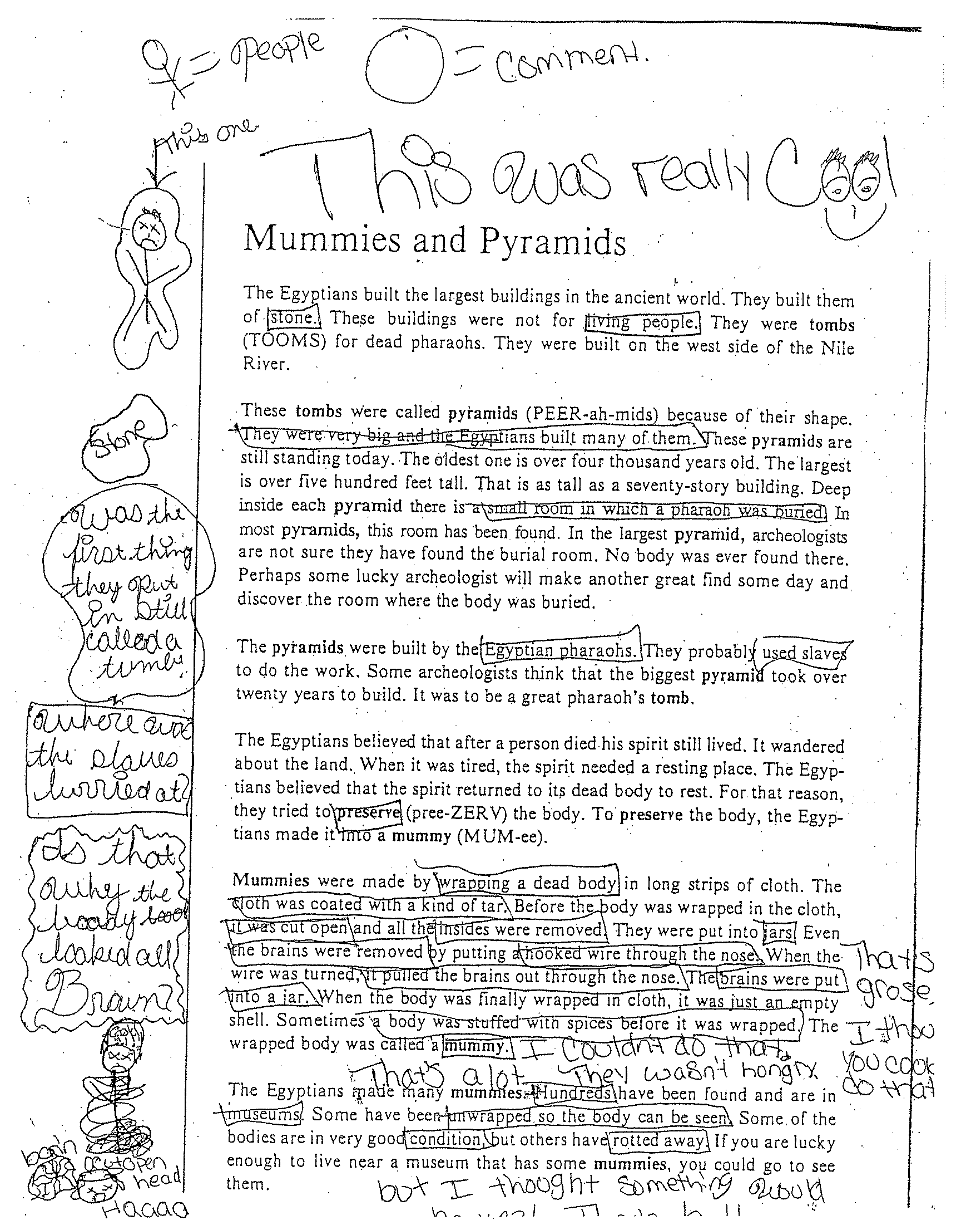
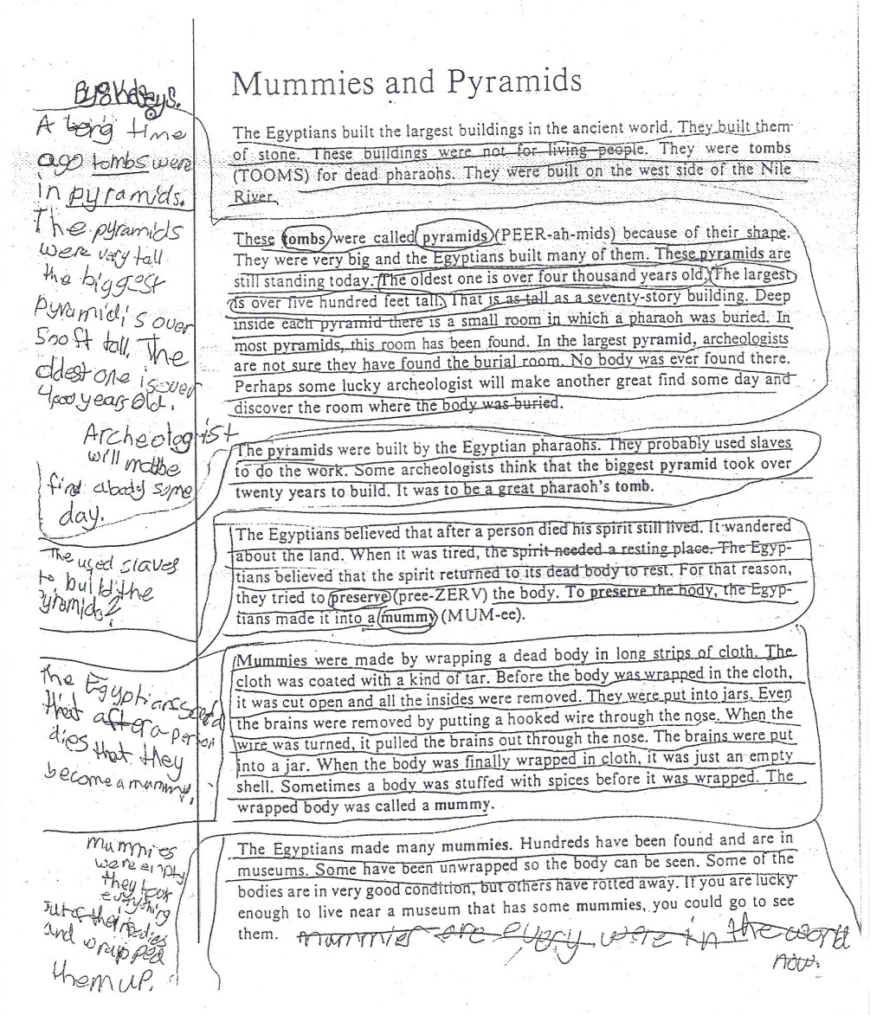
Good discussions require “seeds” to grow.

Slide 14
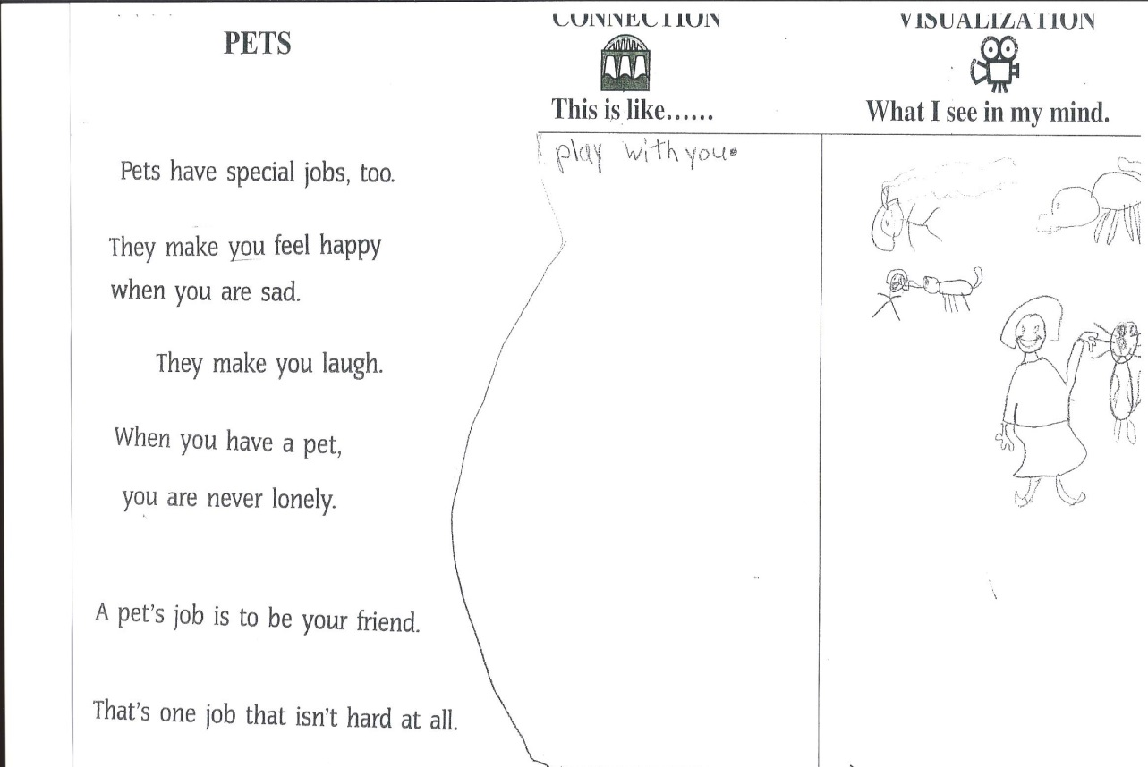
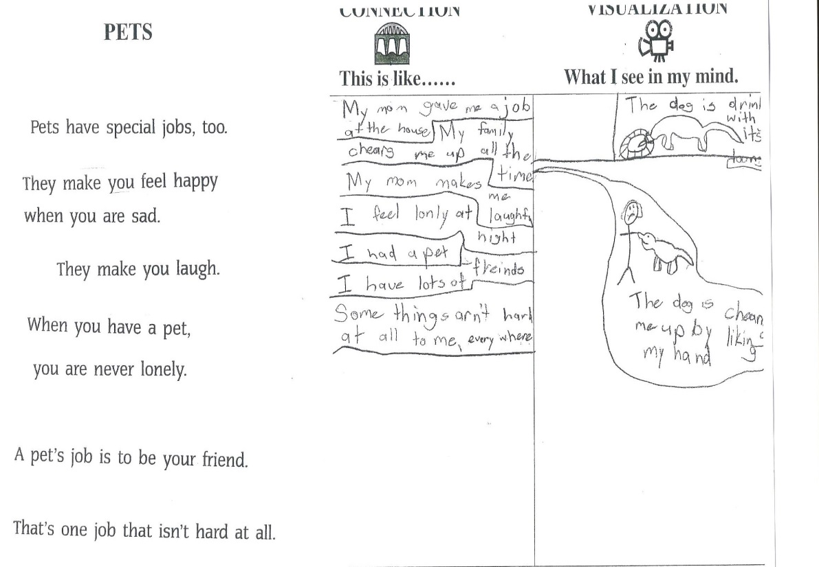

Slide 15
Double Entry Journals
What I Read What I Visualized
What I Read What I Inferred
Conclusion Support
What ‘s Important What’s Interesting
Text Structure Examples from the Text

Slide 16
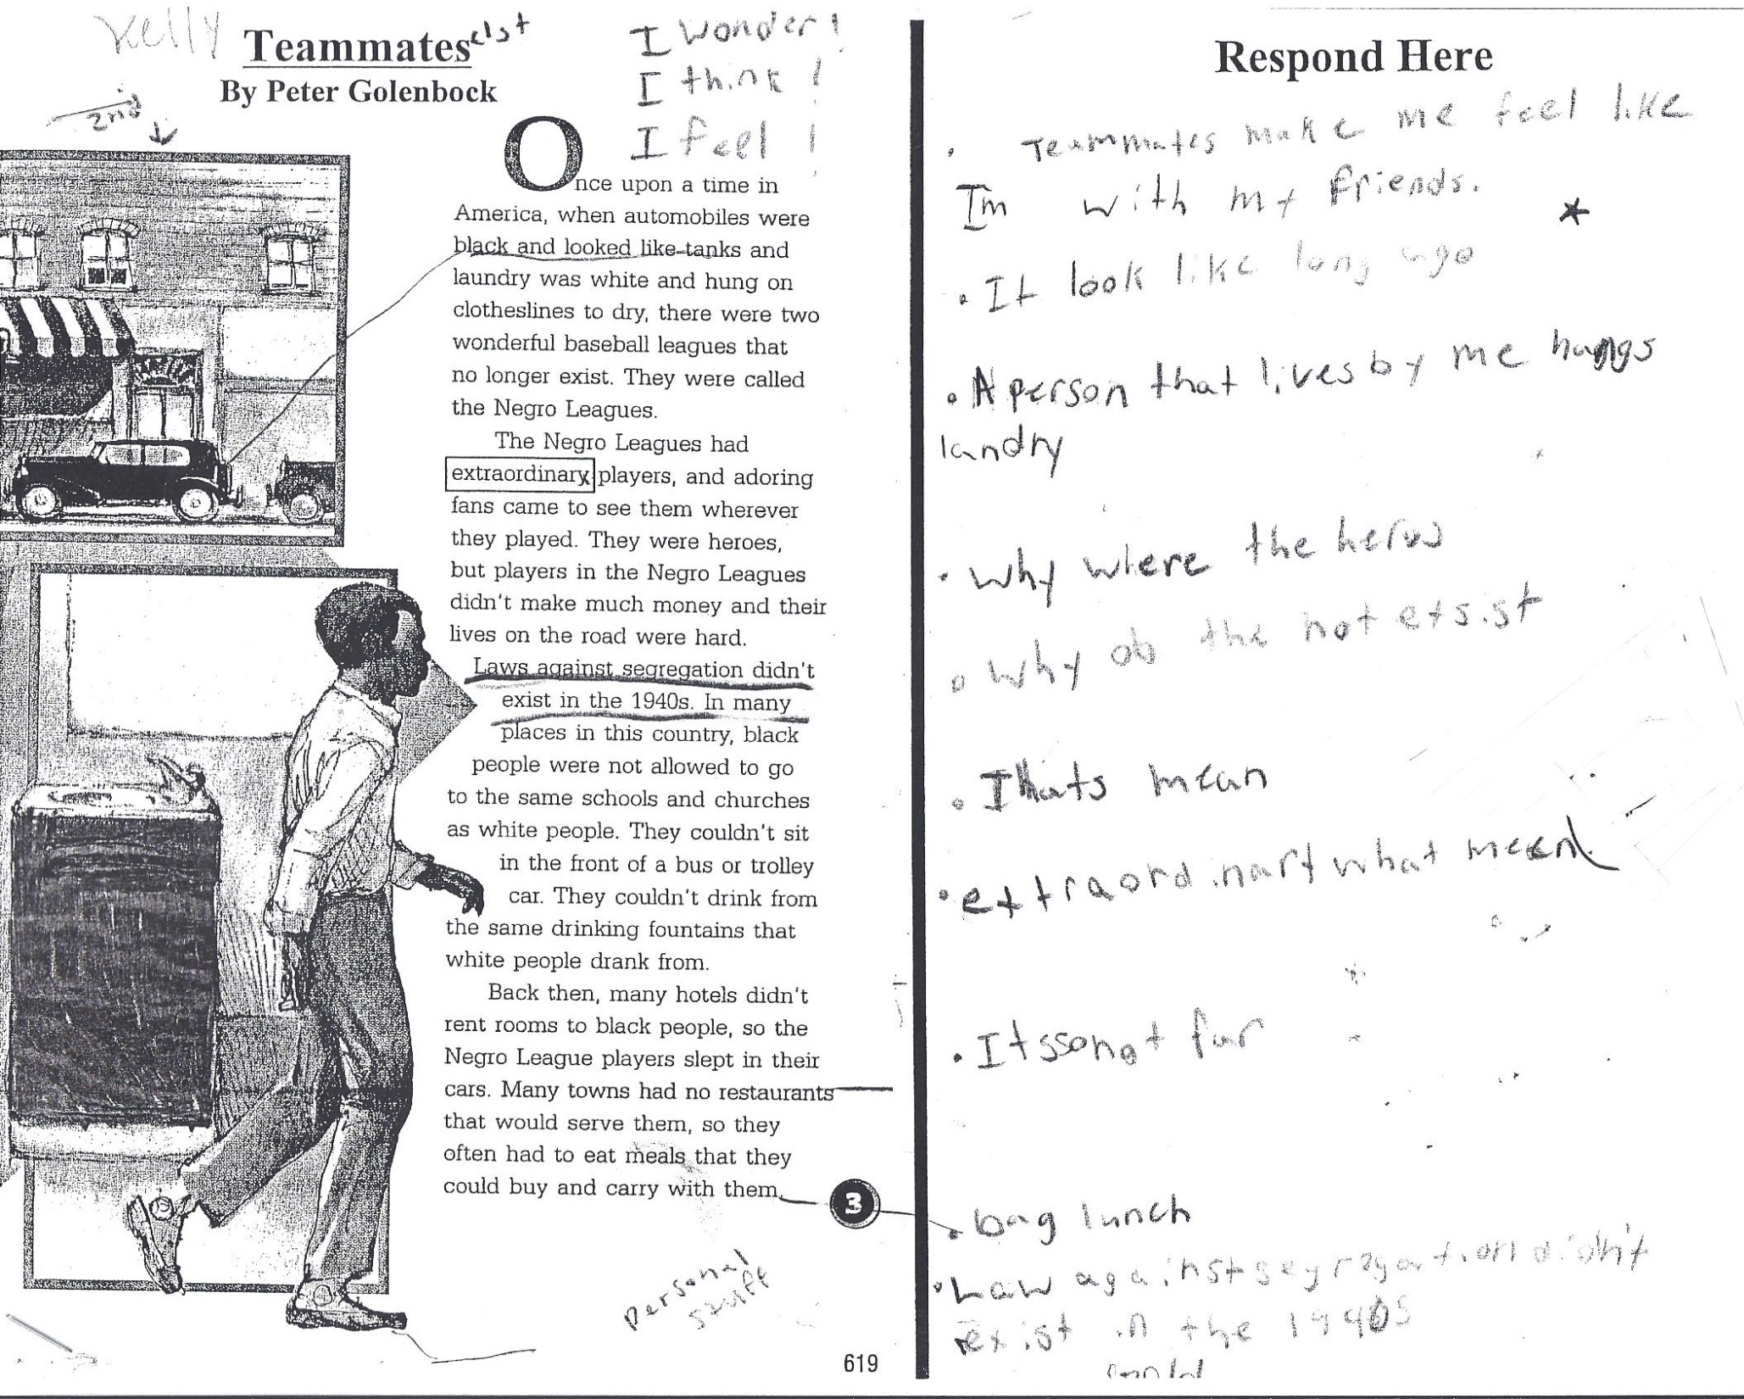

Slide 17
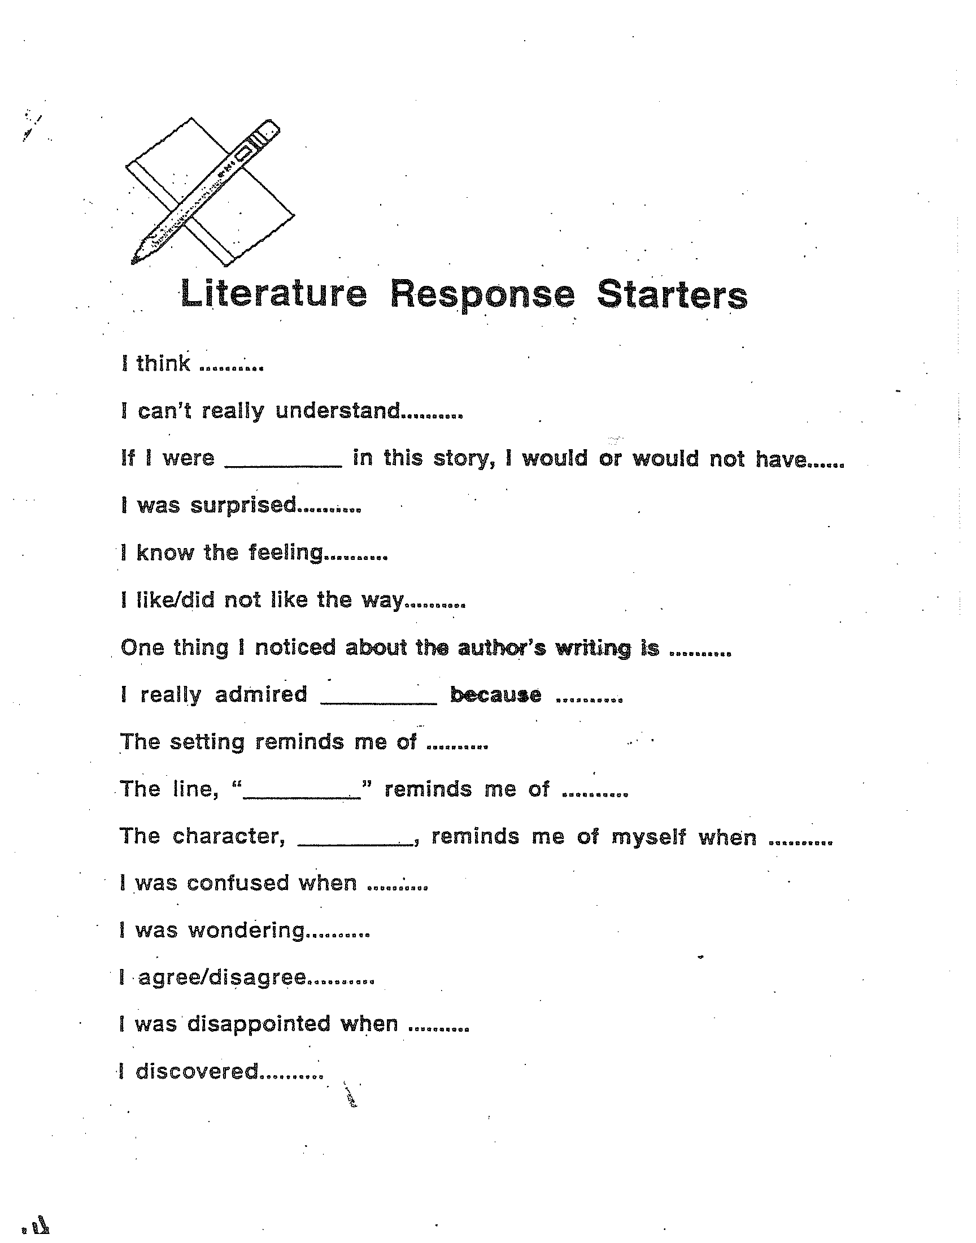
Journaling and Discussion Starters

Slide 18
Annotation Codes
LEARN
L = Learned new information
E = Explored the cause & effect
A = Arrived at a conclusion
R = Recognized different perspectives
N = Noticed important facts
SHARP
S = makes me Sad
H = makes me Happy
A = Anticipates something
R = Reminds me of something
P = sees a Problem
Code for Understanding
* = Interesting
BK = background knowledge
? = question
C = confused
L = learned something new
W = wondering what a word means
S = surprising information

Slide 19
Sticky-Note Discussions
Effective way to engage students with text as they read
Literature groups
Mathematics word problems
Challenging informational text

Slide 20
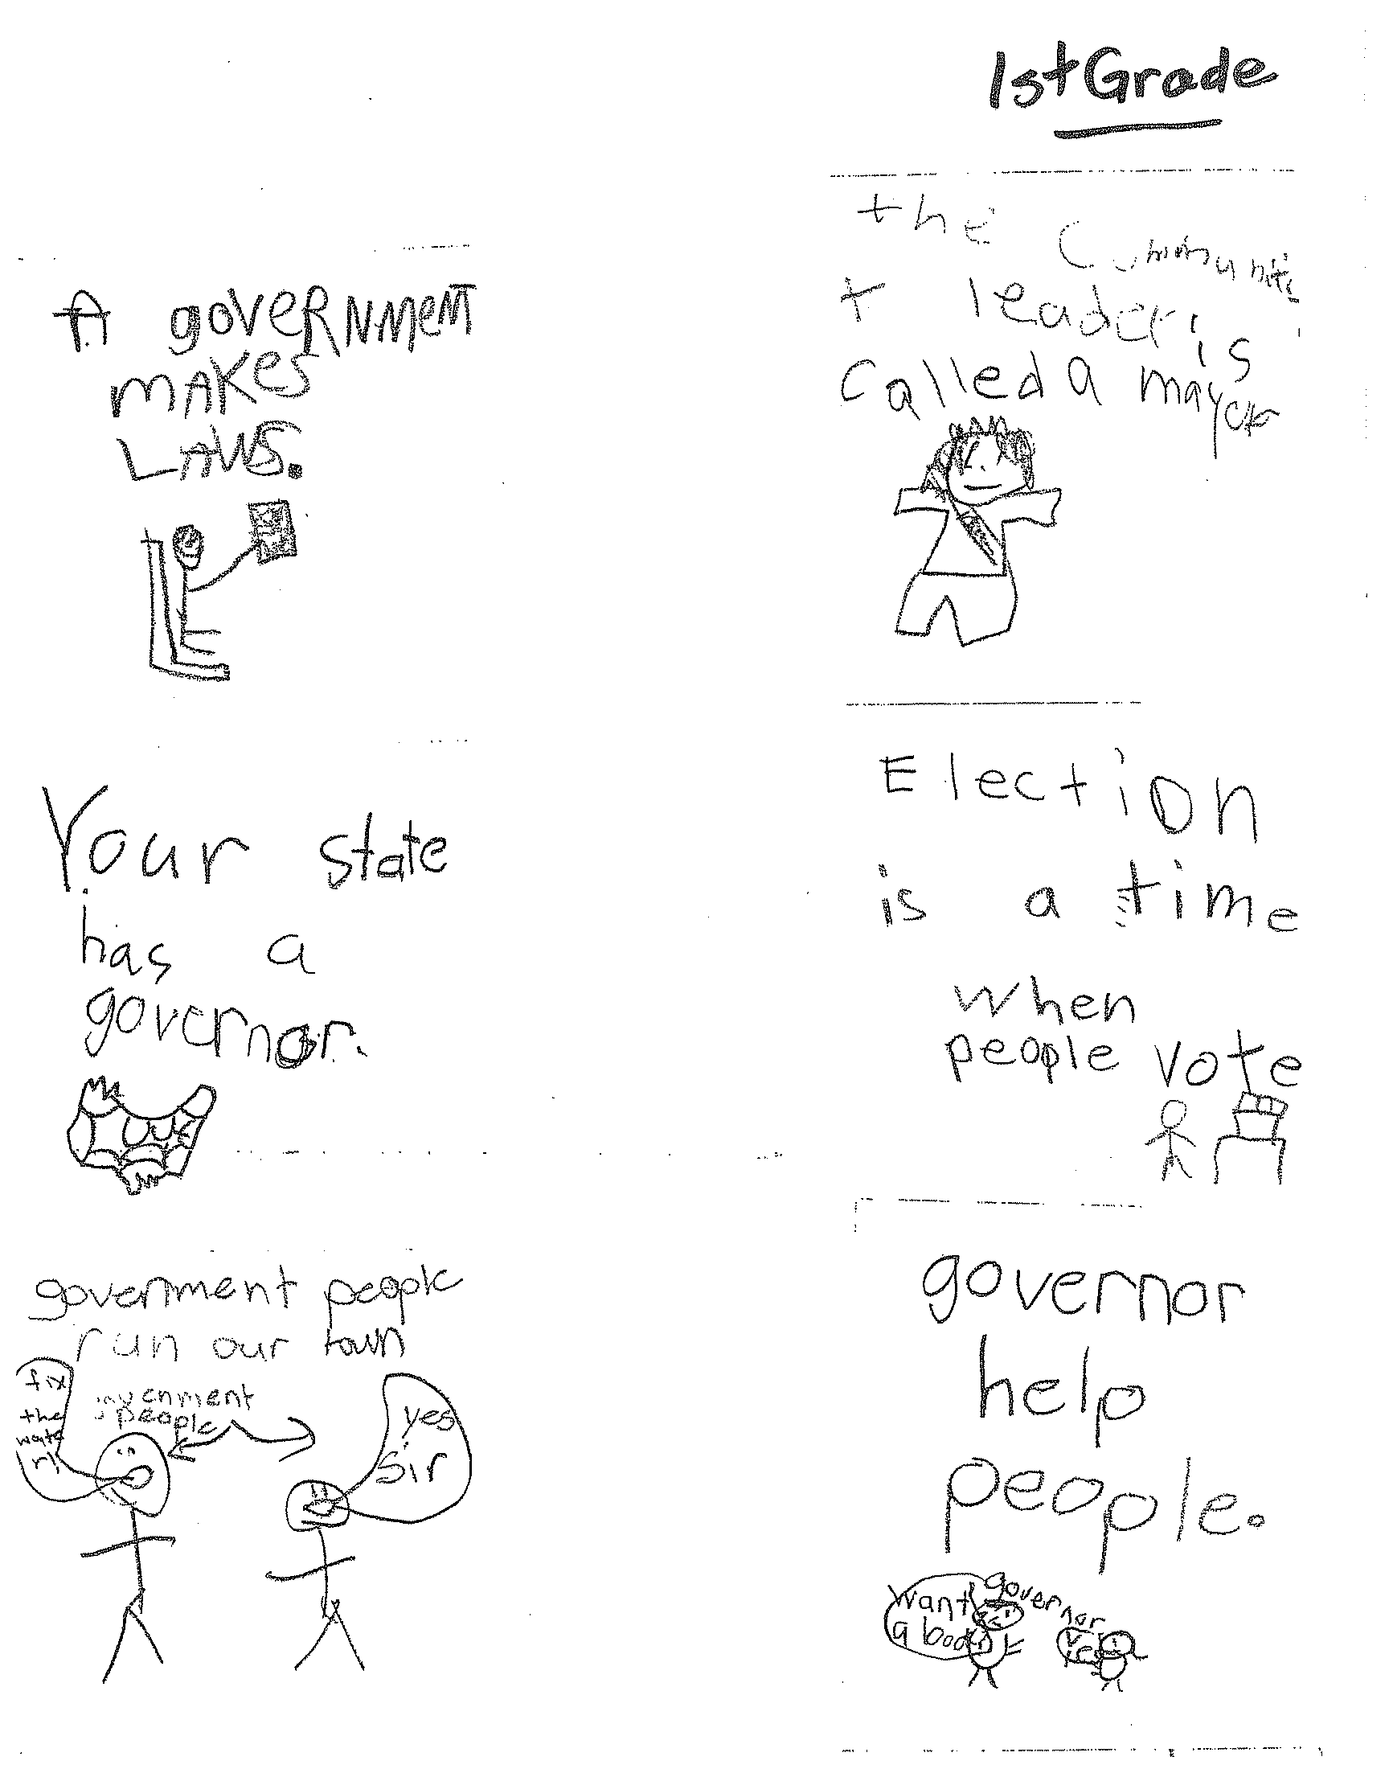
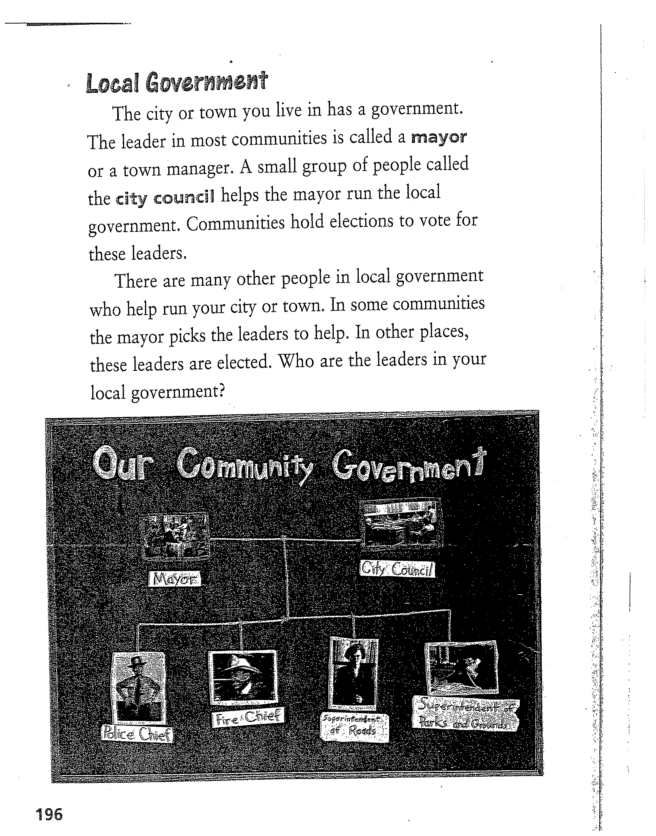
1st Grade

Slide 21
React to the Fact
Identify facts on sticky notes
“React to the Fact” with questions, opinions, feeling, connections
Share facts with group
Take notes on group member’s facts and reactions
Project CRISS, 2012

Slide 22
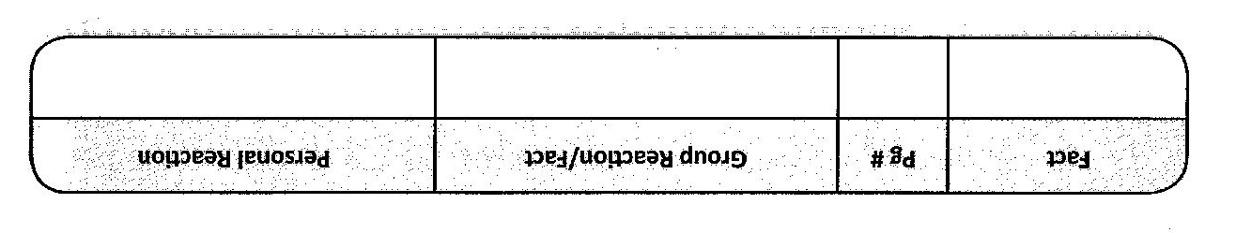
React to the Fact (cont.)
Students independently record most interesting or controversial facts
Write a personal reaction to expand their own understanding.
Project CRISS, 2012

Slide 23
Reflection
For students to become effective metacognitive learners, they must have time during and after a learning experience to evaluate their learning.
L. Baker, 2008

Slide 24
Reflect as a Learner
Teacher Directed:
How did you take responsibility in your group today?
What did you enjoy about discussing (content) with your partner or group this week?
Student Directed:
How did discussion help me understand the content of today’s lesson?
How was I actively engaged?

Slide 25
Discussion Starters
Regarding what you have experienced so far, turn to a neighbor and . . .
1. Summarize what you heard, read, or saw
I learned that...
2. Ask a question about the material
I wonder...
Why or why not...
3. Tell something you found interesting or surprising
I was surprised that...
It is interesting that...
4. Other: anything else related to the topic
This reminds me of…
Notes:
25

Slide 26
Discussion
An active, constructive, and social process for learning
Discretionary Discussion
Teacher +1
Minimal participation for majority
VS.
Instructional Conversations
Students initiate own inquiries and
respond to one another, and/or
mandated participation.
Project CRISS, 2012
Notes:
26

Slide 27
Questioning to Prompt Discussion
Quality of questions/prompts
Invite a response; promote thinking
Enable student reflection
Allow for clarification and elaboration
Student responses are valued
Adapted from C. Danielson, 2007
Notes:
Quality questions are divergent rather than convergent; invite a response, open-ended; lead to a discussion rather than a specific answer. I invite students to formulate a hypothesis, form an opinion, make a connection
In an excellent classroom, these characteristics are exhibited by the students as well as the teacher.
Prompts such as “what made you say that?” or “How have you changed now that we have finished this lesson?” enables student reflection
“Does anyone agree/disagree with that?” or “who can tell me more about that?” “Can you tell me more about that?’” allows for elaboration
These probing questions make the learner feel validated and taken seriously.
But these in-depth responses require processing time. It is often good to allow students to write down their thoughts before sharing. Allowing them to turn to a partner and share their thoughts first is also a good technique. Teachers should ask fewer of these types of questions but go deeper so more instructional time is required. Careful and deliberate planning for these discussions is critical.

Slide 28
Open-Ended Questions…
are those that have no right or wrong answer.
promote student engagement.
draw on students own thoughts, knowledge, skills, experiences, and feelings.
“In a classroom rich with open-ended questioning, children talk more than the teacher. This is true active learning. “
“Open-Ended Questions: Stretching Children’s Academic and Social Learning” from The Power of Our Words by Paula Denton, EdD (Northeast Foundation for Children, 2007)

Slide 29
Ten open-ended questions that facilitate good discussions
1. "Which of the five points we just discussed most applies to you? Why?"
2. "What do you think about that?"
3. "How does this section affect you?"
4. "What did you learn from this study?"
5. "What is one box you checked? Why?"
6. "Which of these points do you need to work on?"
7. "How does the memory verse relate to the chapter and to your life?"
8. "Which point in this chapter spoke to you the most?"
9. "Does anyone disagree with a point in this chapter? If so, why?"
10. "What was your favorite part about this lesson? Why?"
https://www.dougbrittonbooks.com

Slide 30
cognitive growth…
…occurs more likely when one is required to explain, elaborate, or defend one’s position to others as well as to oneself; striving for an explanation often makes a learner integrate and elaborate knowledge in new ways.
L. Vygotsky

Slide 31
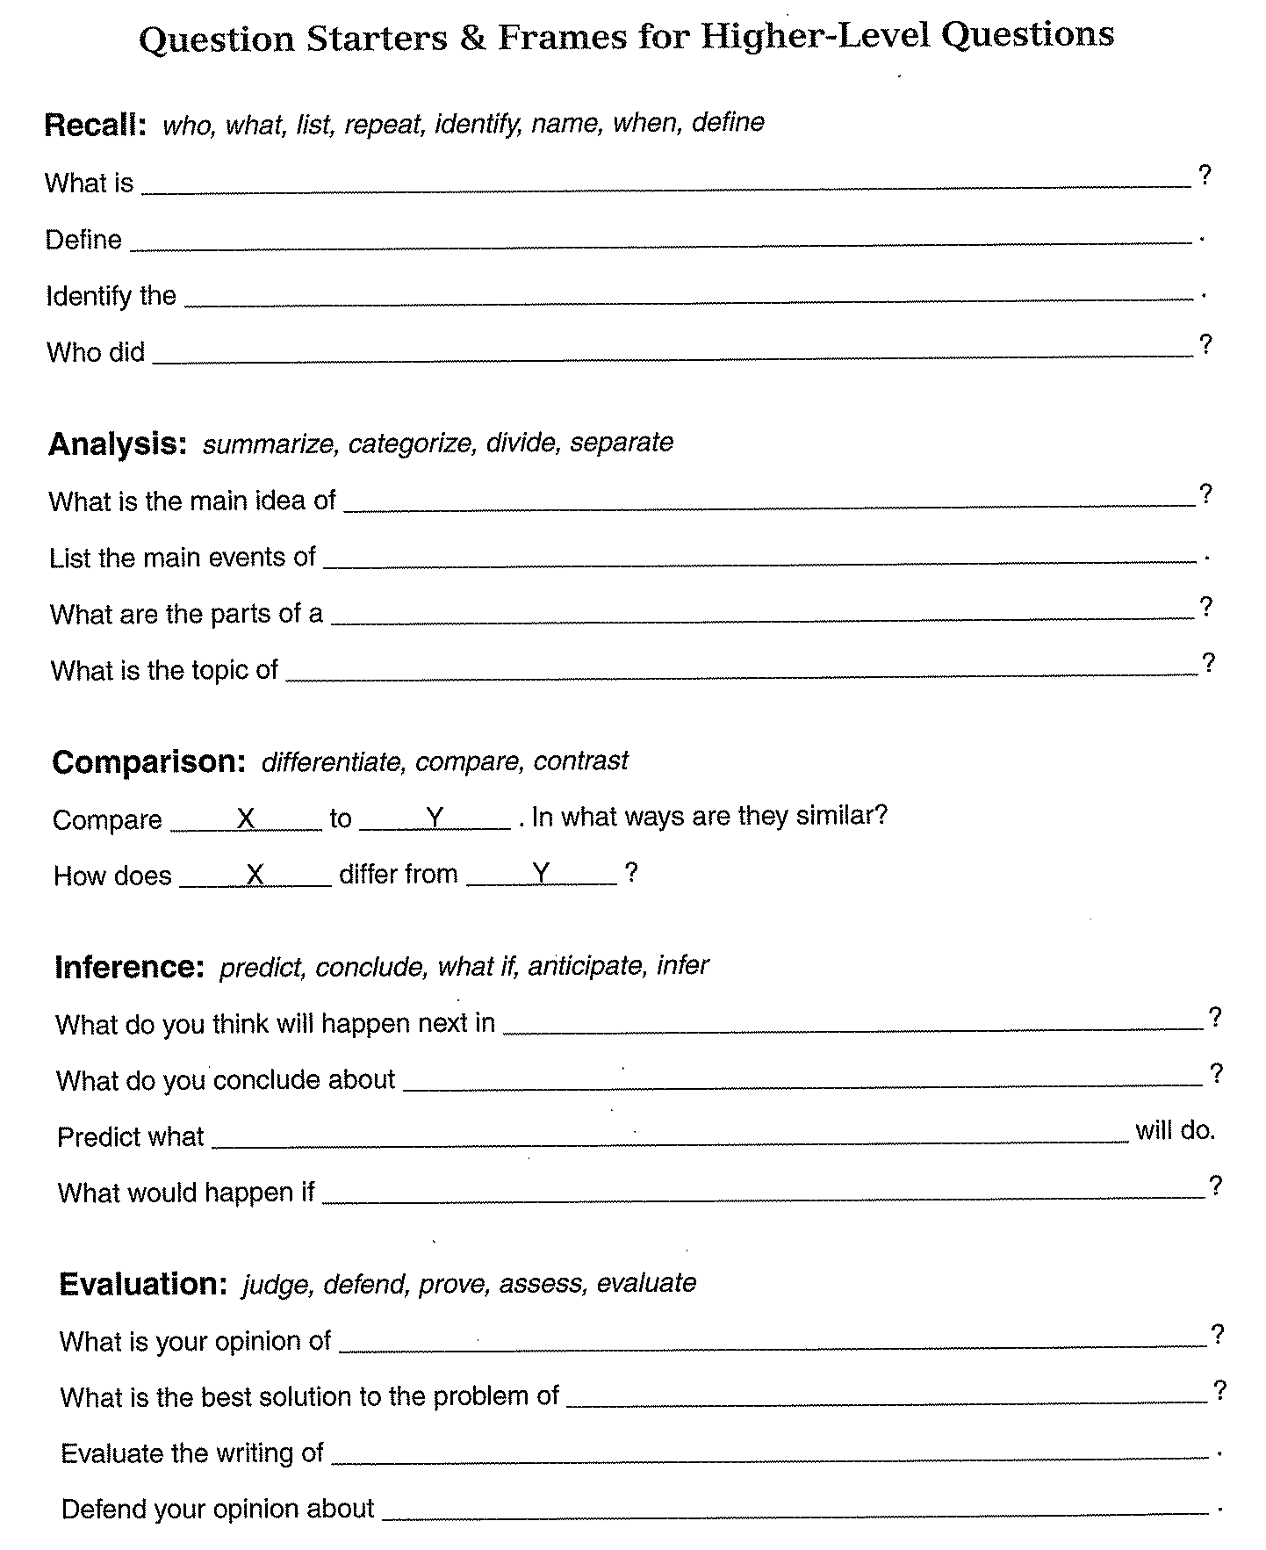
convergent
Question Frames
Project CRISS©, 2012
divergent
https://education.illinoisstate.edu/downloads/
casei/5-02-Revised%20Blooms.pdf

Slide 32
Small-Group Discussion Structures
Small-Group Discussion Activities
Book Clubs
Collaborative Reasoning
Instructional Conversations
Literature Circles
Inquiry Circles
Socratic Seminars
Think-Write-Pair Share
Text Annotation
Turn-To-Your-Partner
Journaling
Sticky Notes
React-To-The-Fact
Three-Minute Pause
Discussion Web
Adapted McElhone, 2014
Retrieved from reading.org

Slide 33
Three-Minute Pause
Meet in groups of 3-5.
Define or summarize key points.
Add own thoughts
Ask clarifying questions.
©Project CRISS® 2006
Notes:
Three-minute pause promotes chunking of the information being presented.
Students pause while reading, watching a video, or listening to a lecture and turn to their partner or group for three minutes to “fix” new information in their memory.
Take three minutes to process the information you just heard
33

Slide 34
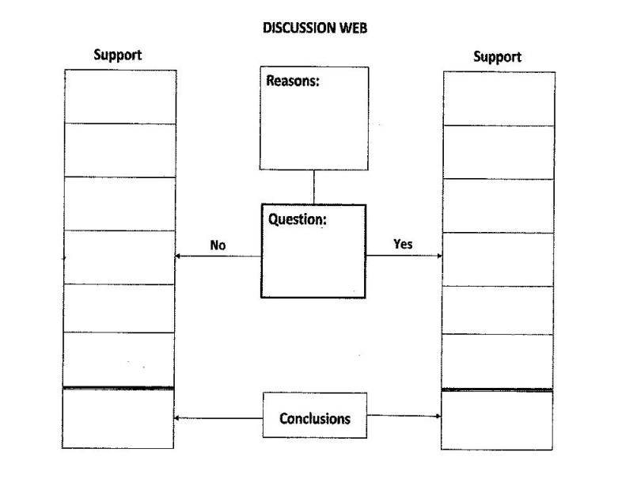
Discussion Web
Promotes understanding of different points of view
Actively involves all students
Can extend into opinion/argumentative writing
Alvermann, 1991; Buehl, 2009

Slide 35
Discussion Web
Write question in middle of grid
Discuss and record reasons for selecting the topic
Brainstorm opposing arguments
Develop conclusions on both sides
Students work in pairs and decide which conclusion seems more valid
Alvermann, 1991; Buehl, 2009

Slide 36
Pattern Puzzle
Help students . . .
Understand patterns and structures.
Sequence events or process steps.
Categorize or group information.
Recognize main ideas and details (when combined with Powers).

